Slide 1




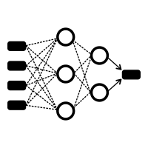
Datasets
Drug Importance of Heart Disease
ML Algorithms
Drug Report
Cosine Similarity Measurement
Coronary
Correlation
Calculator
Importance
Assessor
Feature
Extractor
Strike
Social Group
Migration
ANNs
Weight
Aggregator
MSE/MAE Evaluator
Population
GOPS Framework
GNNs
GCP Buckets

Slide 2
(a)
(b)
(c)
(d)
(e)
(f)

Slide 3
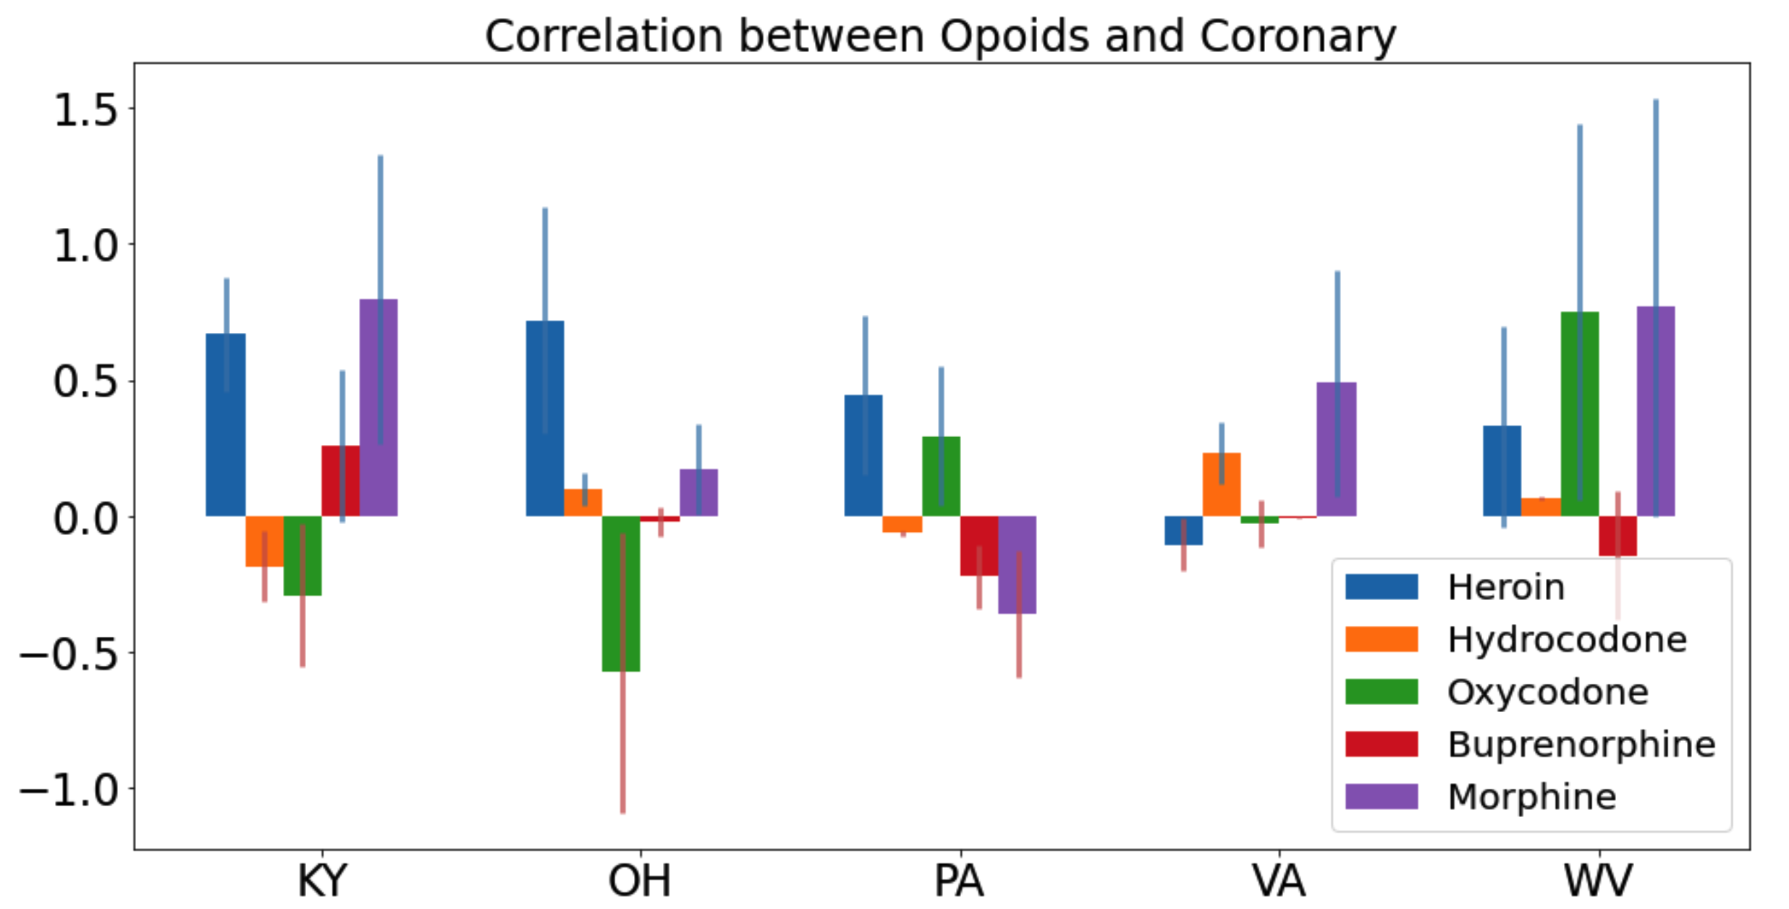
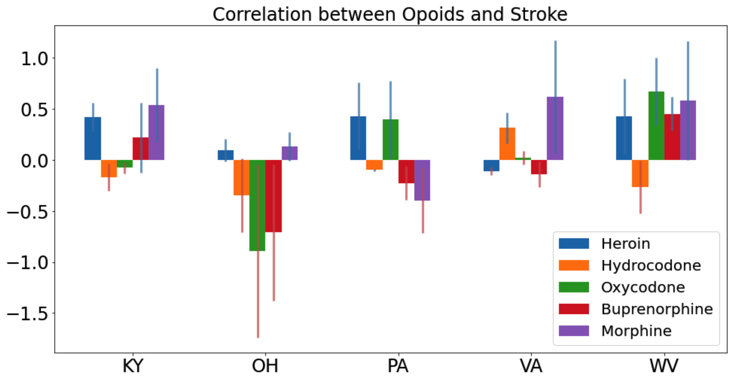

Slide 4
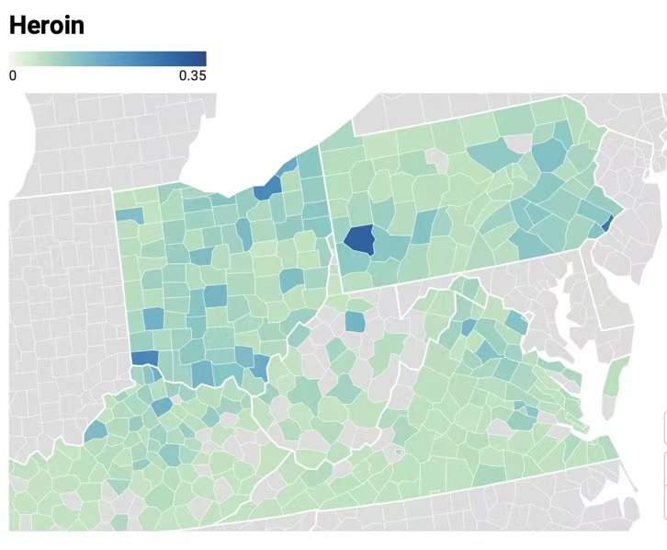
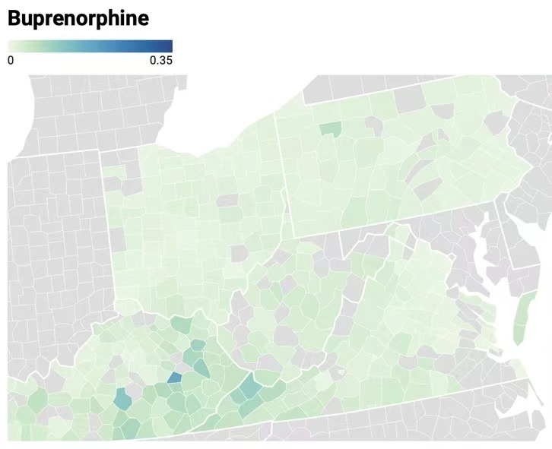
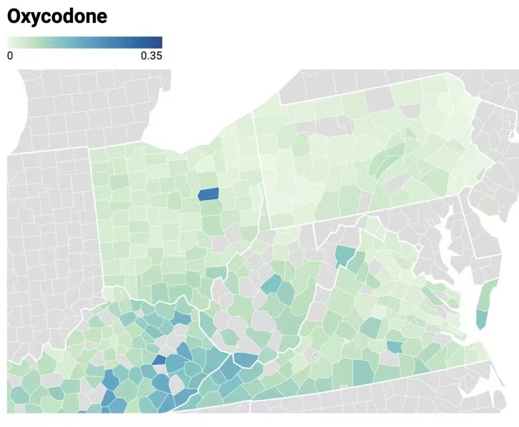
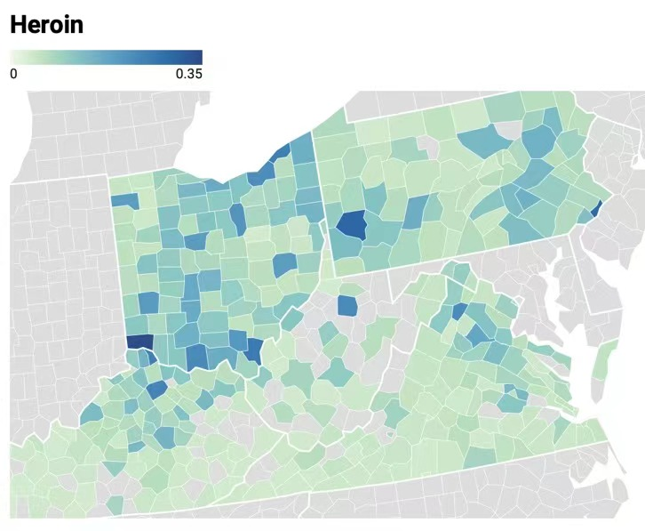
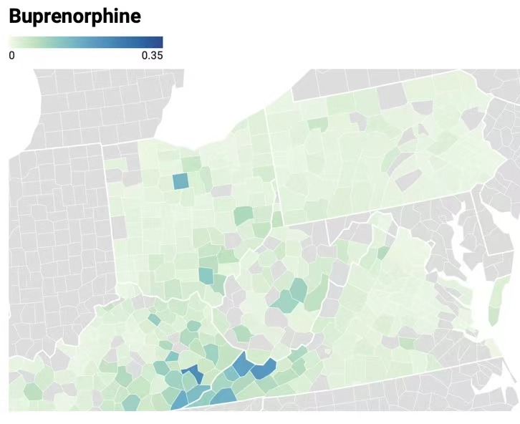
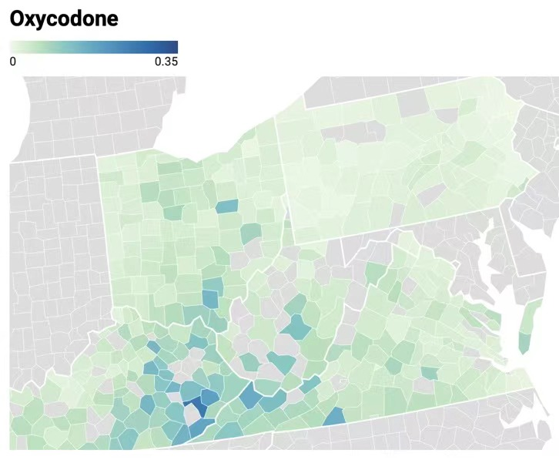
(a)
(b)
(c)
(d)
(e)
(f)

Slide 6
(a)
(b)
(c)
(d)

Slide 7
(b)
(a)

